Slide 1
Nuclear Based MRI
Under supervision of : Dr.Inas Yassine
Team Names:
Marwa Abdullah
Menna Hamdy
Mostafa Yehia
Fady Tadrous

Slide 2
Introduction

Slide 3

Sequence Objective
All hybrid PET/MRI systems are mainly affected by suboptimal attenuation correction factors
It is not directly related to the electron density and linear tissue attenuation coefficients as in PET / CT
It is not straightforward to use MRI metrics for attenuation correction
The MR image is eventually segmented into areas with different attenuation values (bone, brain tissue, fluid, and air in the paranasal sinuses), and this attenuation map is then applied to the PET images

Slide 4
Sequence description

Slide 5
Whole-body diffusion-weighted imaging is especially challenging, Why?
Pulse sequences that are inherently fast by design are typically used in PET/MRI protocols.
These include single-shot fast spin echo (SSFSE) for T2-weighted imaging and two-point Dixon for T1-weighted imaging.

Slide 6
Single-shot fast spin-echo pulse sequences
Acquire a complete 2D image following a single RF excitation.
the main limitations of this technique are blurring, respectively counterbalanced by relatively low resolution and long repetition times.
Technical developments now adopted by all major vendors have improved speed and resolution .

Slide 7
Note:
While the clinical acceptance of single-shot fast spin echo is increasing, conventional fast spin echo is still often preferred for superior image quality, despite the longer acquisition times and associated motion sensitivity also STIR and radial fast spin-echo imaging are commonly used.

Slide 8
Cont.
Image quality can be superior to single-shot fast spin echo motion insensitivity comes with longer acquisitions.
T1-weighted imaging is performed using high-resolution 3D gradient-echo pulse sequences .
A proposed alternative for T1-weighted imaging, is 3D radial gradient-echo imaging .
Accelerated imaging strategies can be used to speed up the acquisition, at the cost of reduced signal-to-noise ratio and with performance dependent on the specific array coil used for signal reception.
Parallel imaging methods are standard on clinical PET/MRI systems . They use receive coil arrays, undersample data in k-space.
Compressed sensing utilizes the inherent sparsity of MR images to accelerate acquisitions , which is now implemented for pulse sequences in current commercial scanners. The use of compressed sensing will likely increase in the future.

Slide 9
MR Attenuation Correction:
PET reconstruction requires an estimate of the photon attenuation prior to detection. Which is a challenge for PET/MRI.

Slide 10
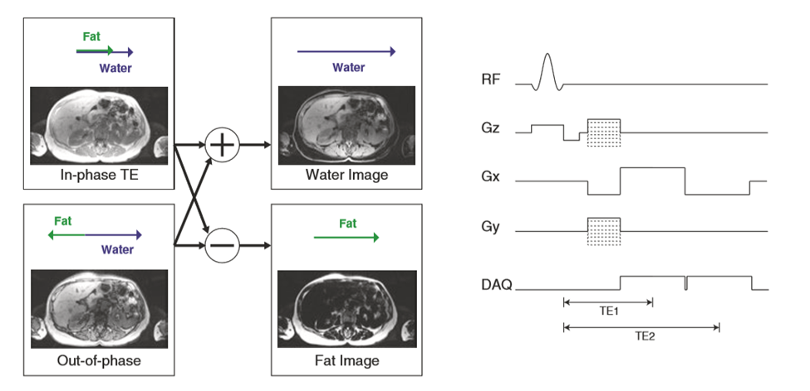
Fat/Water Imaging:
Many MRAC strategies use fat-water separation imaging methods, also known as “Dixon” or “IDEAL” methods [5]. These methods acquire data at multiple echo times (TEs).
For MRAC, typically two-point Dixon approaches are used, as they are faster and the smooth field variation assumption has been shown to be robust for clinical imaging.

Slide 11
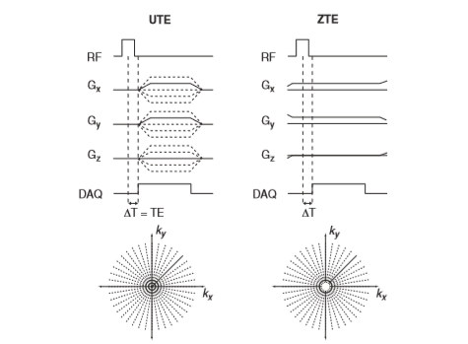
Bone Imaging:
Conventional MR imaging pulse sequences don’t detect any signal from the bone due to its rapid MR signal decay rate.This has been a challenge in PET/MRI because the bone has the largest photon attenuation among all tissue types but is difficult to image with MRI
Specialized MRI pulse sequences (UTE and ZTE) pulse sequences, offer to capture the rapidly decaying signal from the bone and thus are being developed and applied to improve MRAC.

Slide 12
Diffusion-Weighted Imaging:
(DWI) is often achieved by playing out two identical gradient lobes on either sides of the refocusing RF pulse of a spin-echo pulse sequence. Immediately after the RF excitation pulse, all spins are aligned along the same direction in the transverse plane.
The amount of diffusion weighting is expressed by a quantity called b value. The higher the b value, the higher the amount of diffusion weighting.

Slide 13
Whole-Body Diffusion-Weighted Imaging
STIR is the preferred fat-suppression method for whole-body imaging due to its robustness to B0 and B1 inhomogeneities, despite the lower intrinsic SNR.
DWIBS (diffusion- weighted imaging with background suppression). Whole-body diffusion imaging is performed axially, with coronal/sagittal reformats generated for the purpose of visualization.

Slide 14
Lung Imaging:
Pulmonary imaging is challenging for MRI due to low tissue density, motion, and rapid signal decay rates .
The ultrashort echo-time (UTE) and zero echo-time (ZTE) MRI pulse sequences, described previously are also a promising approach for lung imaging.
Compressed sensing and parallel imaging strategies can also be incorporated to improve image quality

Slide 15
Image contrast in mri
Proton Density
T₁ Time
T₂ Time
Repetition Time
Echo Time

Slide 16
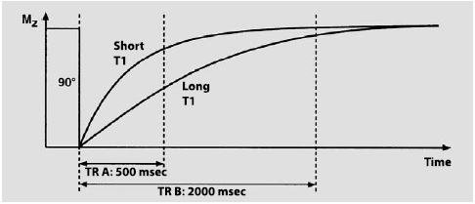
Repetition Time

Slide 17
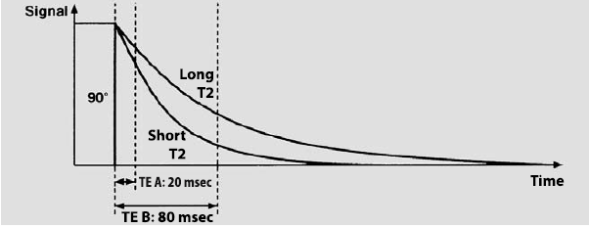
Echo Time

Slide 18
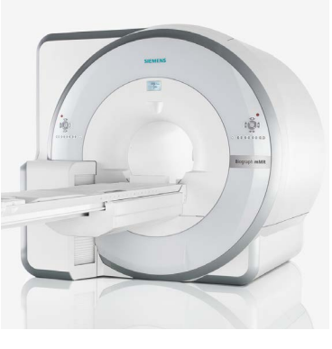
PET/MRI Instrument

